Slide 1
Chapter 2 Atoms, Molecules, and Ions
© 2015 Pearson Education, Inc.

Slide 2
Atomic Theory of Matter
460-370 BC， Democritus and other Greek philosophers, atomos = indivisible or uncuttable.
Later, Plato and Aristotle disagreed, no ultimately indivisible particles
In the early nineteenth century, the theory that atoms are the fundamental building blocks of matter reemerged in championed by John Dalton.

Slide 3
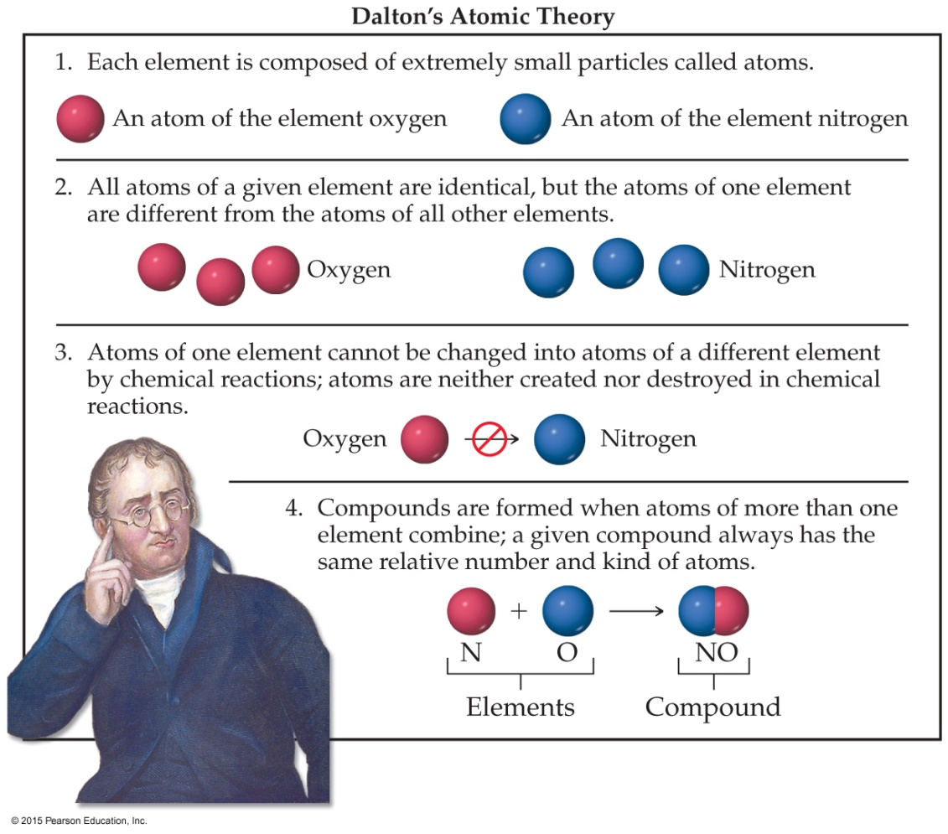
Dalton’s Postulates

Slide 4
Law of Conservation of Mass (质量守恒定律)
The total mass of substances present at the end of a chemical process is the same as the mass of substances present before the process took place.
This law was one of the laws on which Dalton’s atomic theory was based.

Slide 5
Law of Multiple Proportions (倍比定律)
If two elements, A and B, form more than one compound, the masses of B that combine with a given mass of A are in the ratio of small whole numbers.
Dalton predicted this law and observed it while developing his atomic theory.
When two or more compounds exist from the same elements, they can not have the same relative number of atoms.

Slide 6
Discovery of Subatomic Particles
In Dalton’s view, the atom was the smallest particle possible. Many discoveries led to the fact that the atom itself was made up of smaller particles.
Cathode rays and Electrons
Radioactivity
Nucleus, protons, and neutrons

Slide 7
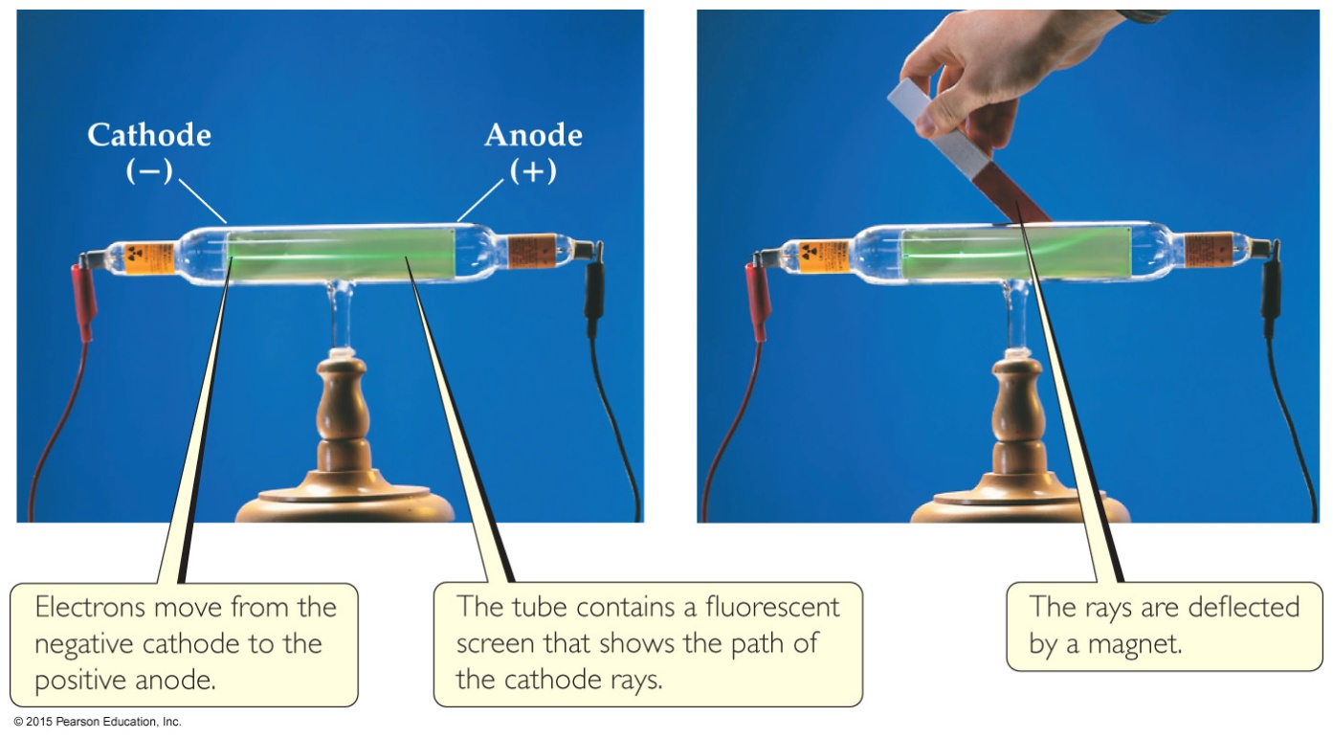
The Electron (Cathode Rays)
Streams of negatively charged particles were found to emanate （发出） from cathode tubes, causing fluorescence.
J. J. Thomson is credited with their discovery (1897).

Slide 8
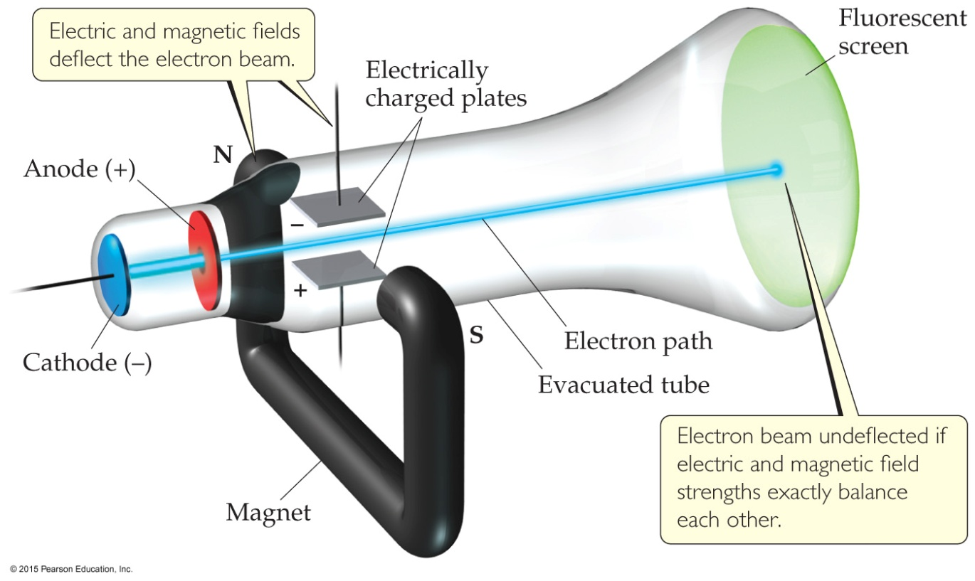
The Electron
Lorentz force
Left-hand rule
Magnetic line of force
Thomson measured the charge/mass ratio of the electron to be 1.76 × 10⁸ coulombs/gram (C/g).

Slide 9
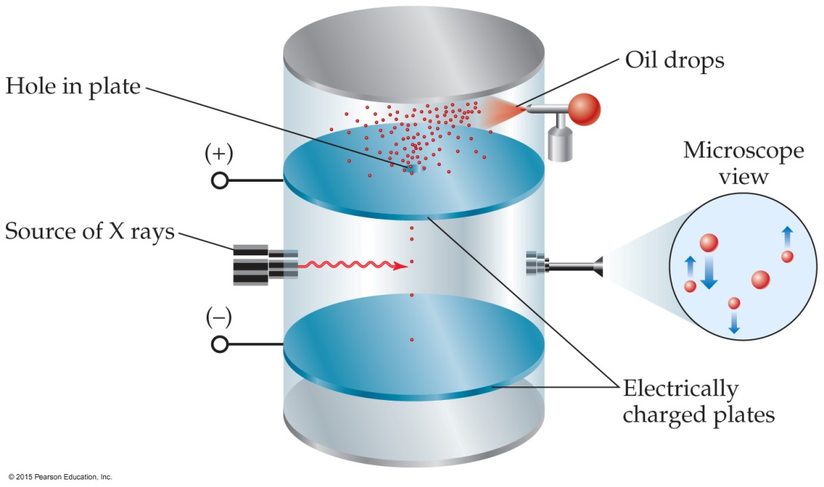
Millikan Oil-Drop Experiment (Electrons)
Once the charge/mass ratio of the electron was known, determination of either the charge or the mass of an electron would yield the other.
Robert Millikan determined the charge on the electron in 1909.
Then the mass of an electron was calculated.
Electron mass: 9.10 × 10⁻²⁸ g
Agrees well with 9.10938 × 10⁻²⁸ g
2000 times smaller than that of hydrogen

Slide 10
Radioactivity (辐射性)
Radioactivity is the spontaneous emission of high-energy radiation by an atom.
It was first observed by Henri Becquerel (贝克勒尔）. (Uranium)
Marie and Pierre Curie isolated it out.
Its discovery showed that the atom had more subatomic particles and energy associated with it.

Slide 11
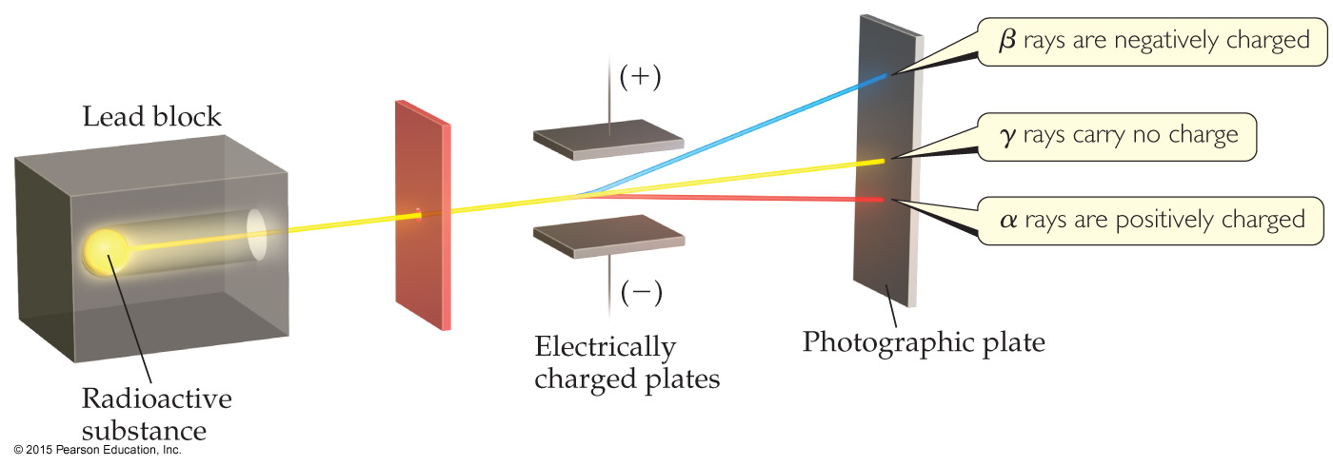
Radioactivity
Three types of radiation were discovered by Ernest Rutherford:
α particles (positively charged，He²⁺ nucleus)
β particles (negatively charged, high-speed electrons)
γ rays (uncharged)

Slide 12
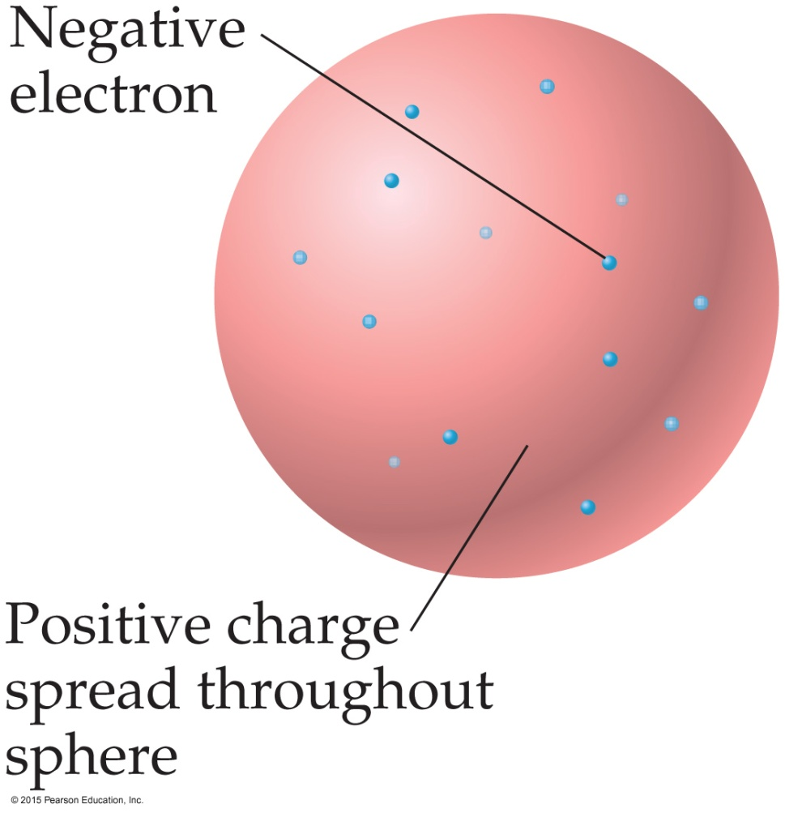
The Atom, circa 1900
Thomson proposed that the prevailing theory of the “plum pudding” model.
It featured a uniform positive sphere of matter with negative electrons embedded in it.

Slide 13
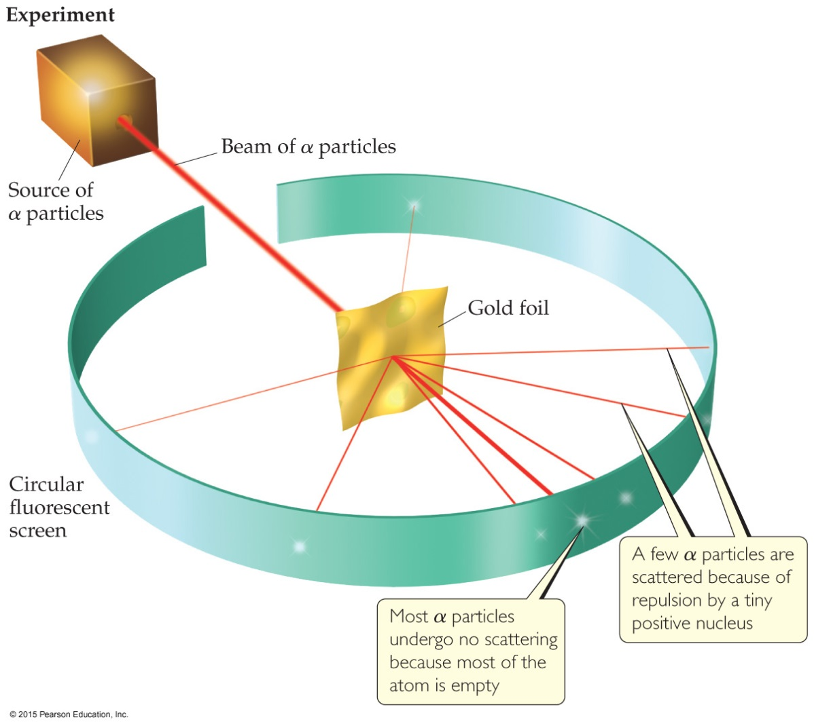
Discovery of the Nucleus (原子核)
In 1910， Ernest Rutherford shot α particles at a thin sheet of gold foil and observed the pattern of scatter of the particles.

Slide 14
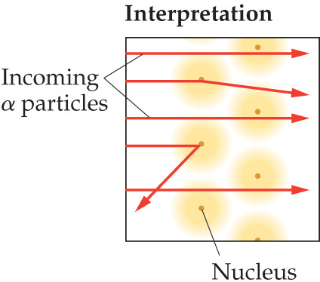
The Nuclear Atom
Since some particles were deflected at large angles, Thomson’s model could not be correct.

Slide 15
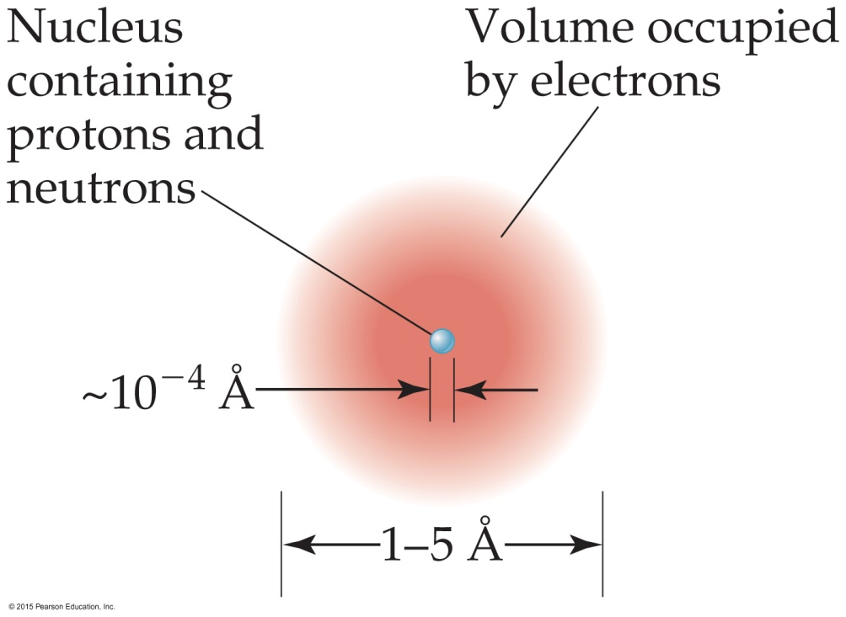
The Nuclear Atom （核型原子）
Rutherford postulated a very small, dense nucleus with the electrons around the outside of the atom.
Most of the volume is empty space.
Atoms are very small; 1 – 5 Å or 100 – 500 pm.
Other subatomic particles (protons were discovered in 1919 by Rutherford, and neutrons in 1932 by Chadwick) were discovered.

Slide 16
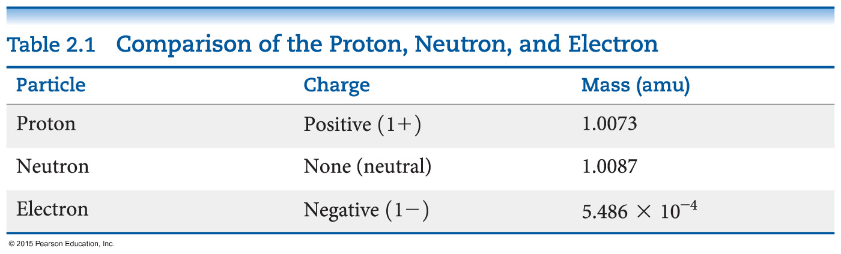
Subatomic Particles
Protons (+1) (质子) and electrons (–1) (电子) have a charge; neutrons (中子) are neutral.
Protons and neutrons have essentially the same mass (relative mass 1). The mass of an electron is so small we ignore it (relative mass 0).
Protons and neutrons are found in the nucleus; electrons travel around the nucleus.

Slide 17
Atomic Mass (原子质量)
Atoms have extremely small masses.
The heaviest known atoms have a mass of approximately 4 × 10^{–22} g.
A mass scale on the atomic level is used, where an atomic mass unit (amu) is the base unit.
1 amu = 1.66054 × 10^{–24} g

Slide 18
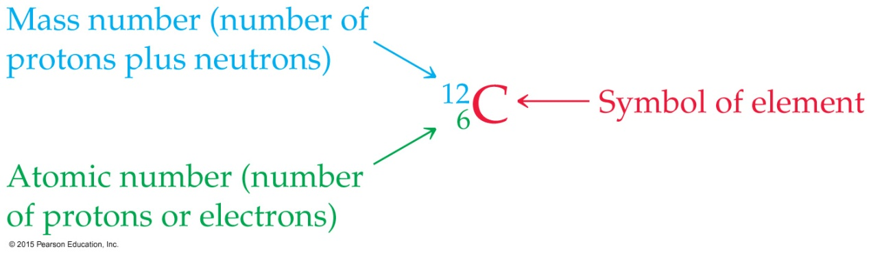
Symbols of Elements
Elements are represented by a one or two letter symbol (元素符号). This is the symbol for carbon.
All atoms of the same element have the same number of protons, which is called the atomic number, Z. (原子数) It is written as a subscript BEFORE the symbol.
The mass number (质量数) is the total number of protons and neutrons in the nucleus of an atom. It is written as a superscript BEFORE the symbol.

Slide 19
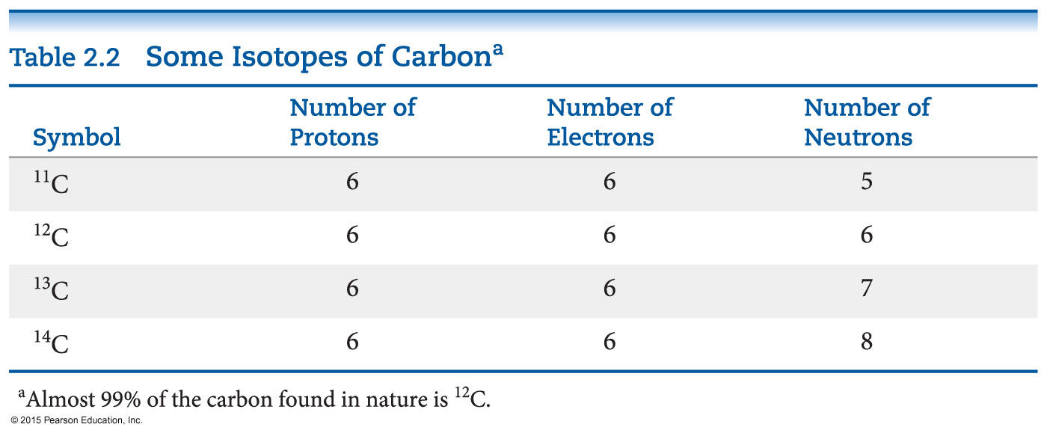
Isotopes (同位素)
Isotopes are atoms of the same element with different masses.
Isotopes have different numbers of neutrons, but the same number of protons.

Slide 20
Atomic Weight (原子量)
Because in the real world we use large amounts of atoms and molecules, we use average masses in calculations.
An average mass is found using all isotopes of an element weighted by their relative abundances. This is the element’s atomic weight.
Atomic Weight = Ʃ [(isotope mass) × (fractional natural abundance)].
Note: the sum is for ALL isotopes of an element.

Slide 21
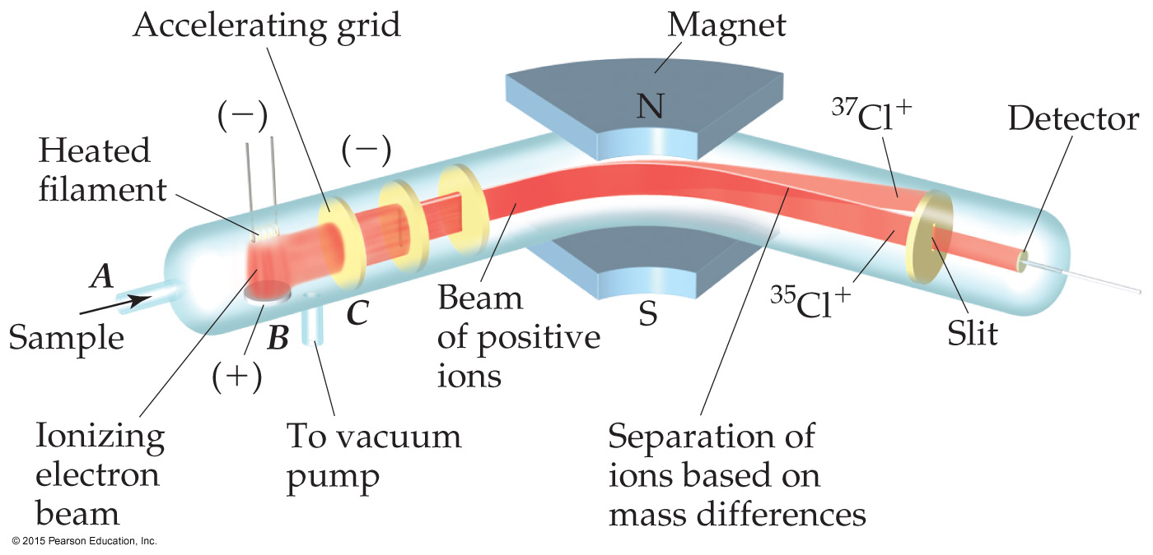
Atomic Weight Measurement
Atomic and molecular weight can be measured with great accuracy using a mass spectrometer (质谱).

Slide 22
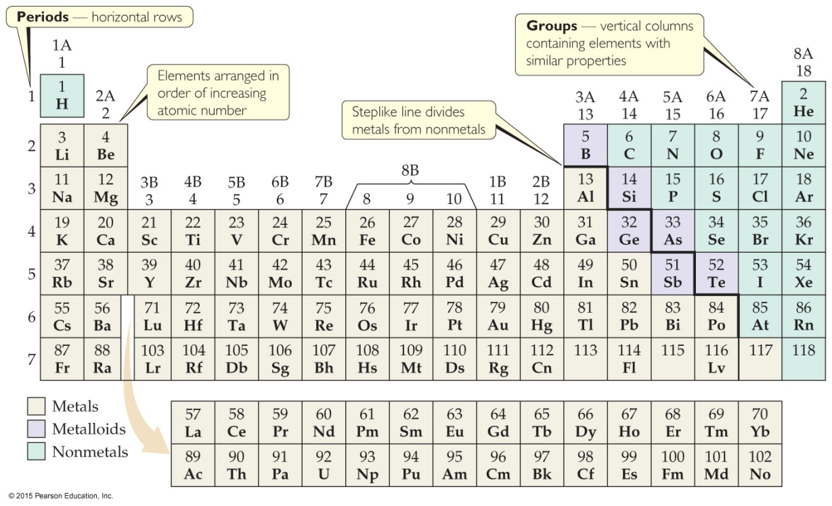
Periodic Table of Elements（元素周期表）
The periodic table is a systematic organization of the elements.
Elements are arranged in order of atomic number.
Unlike the way we write isotopes, the atomic number is at the TOP of a box in the periodic table.
The atomic weight of an element appears at the BOTTOM of the box. Page 1

Slide 23

Periodic Table
The rows on the periodic table are called periods (周期).
Columns are called groups (族).
Elements in the same group have similar chemical properties.

Slide 24
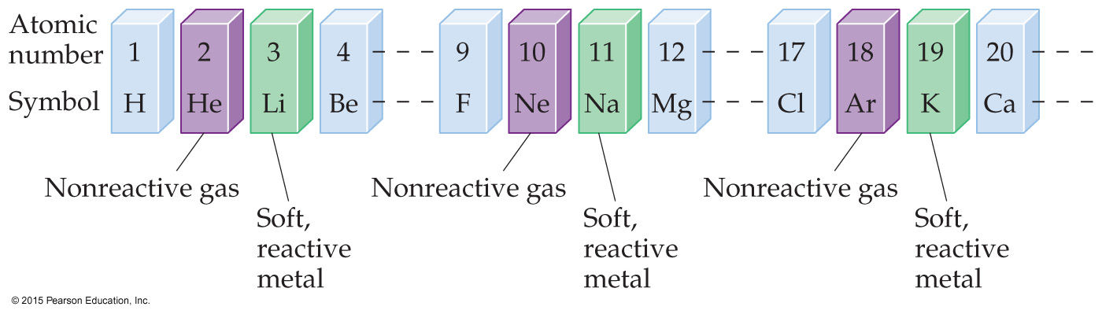
Periodicity (周期性)
When one looks at the chemical properties of elements, one notices a repeating pattern of reactivities.

Slide 25
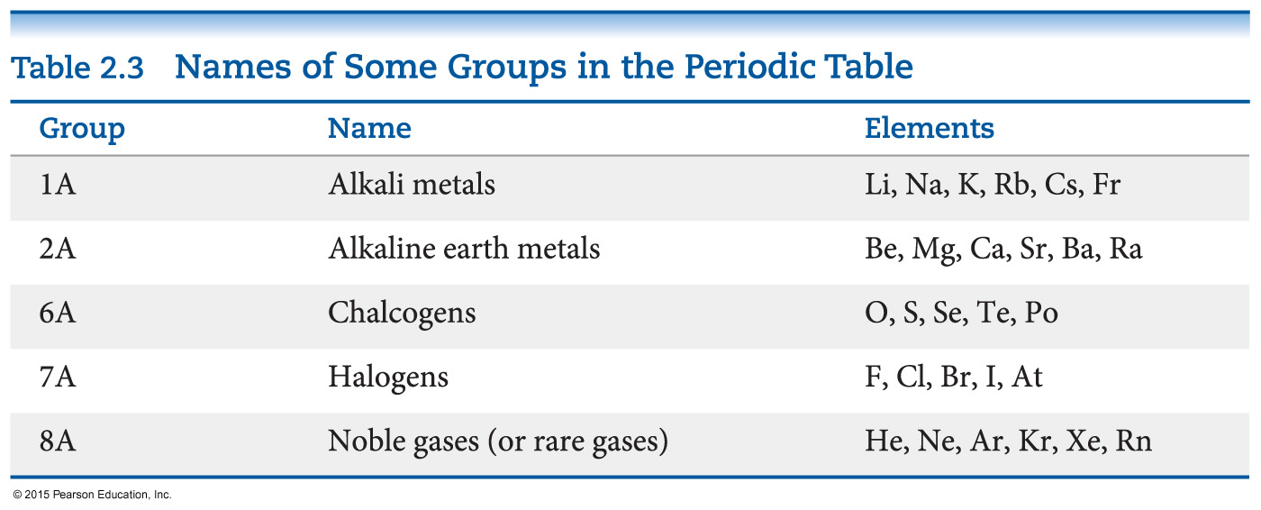
Groups (族)
These five groups are known by their names.

Slide 26

Periodic Table
Metals are on the left side of the periodic table.
Some properties of metals include
shiny luster.
conducting heat and electricity.
solidity (except mercury).

Slide 27

Periodic Table
Nonmetals are on the right side of the periodic table (with the exception of H).
They can be solid (like carbon), liquid (like bromine), or gas (like neon) at room temperature.

Slide 28
Periodic Table
Elements on the steplike line are metalloids （准金属）(except Al, Po, and At).
Their properties are sometimes like metals and sometimes like nonmetals.
Boron, Silicon, Germanium, Arsenic, Stibium, Tellurium

Slide 29
The nucleus of an atom contains
protons and neutrons.
protons and electrons.
electrons and neutrons.
protons, neutrons, and electrons.
Notes:
Answer: a

Slide 30
The nucleus of an atom contains
protons and neutrons.
protons and electrons.
electrons and neutrons.
protons, neutrons, and electrons.
Notes:
Answer: a

Slide 31
Two atoms with the same atomic number but different mass numbers are called
mutants.
isomers.
isotopes.
symbiots.
Notes:
Answer: c

Slide 32
Two atoms with the same atomic number but different mass numbers are called
mutants.
isomers.
isotopes.
symbiots.
Notes:
Answer: c

Slide 33
Select the incorrect statement about the mass and volume of an atom.
The mass is determined mostly by the protons and neutrons.
The volume is mostly empty space.
The mass is concentrated in the nucleus.
The volume is determined by the arrangement of the protons.
Notes:
Answer: d

Slide 34
Select the incorrect statement about the mass and volume of an atom.
The mass is determined mostly by the protons and neutrons.
The volume is mostly empty space.
The mass is concentrated in the nucleus.
The volume is determined by the arrangement of the protons.
Notes:
Answer: d

Slide 35
For an atom of fluorine, the atomic number is ___ and the average atomic mass is ___.
9; 18.988 amu
18.998; 9 amu
10; 19 g
9; 9 g
Notes:
Answer: a

Slide 36
For an atom of fluorine, the atomic number is ___ and the average atomic mass is ___.
9; 18.988 amu
18.998; 9 amu
10; 19 g
9; 9 g
Notes:
Answer: a

Slide 37
Atomic weights on the periodic table are decimal numbers instead of integers because
the number of protons + neutrons determines atomic weight.
of the existence of isotopes.
of the very small mass of electrons compared to protons and neutrons.
the number of protons + electrons determines atomic weight.
Notes:
Answer: b

Slide 38
Atomic weights on the periodic table are decimal numbers instead of integers because
the number of protons + neutrons determines atomic weight.
of the existence of isotopes.
of the very small mass of electrons compared to protons and neutrons.
the number of protons + electrons determines atomic weight.
Notes:
Answer: b

Slide 39
The elements found on the right side of the periodic table tend to ______ electrons.
gain
lose
keep
share
Notes:
Answer: a

Slide 40
The elements found on the right side of the periodic table tend to ______ electrons.
gain
lose
keep
share
Notes:
Answer: a

Slide 41
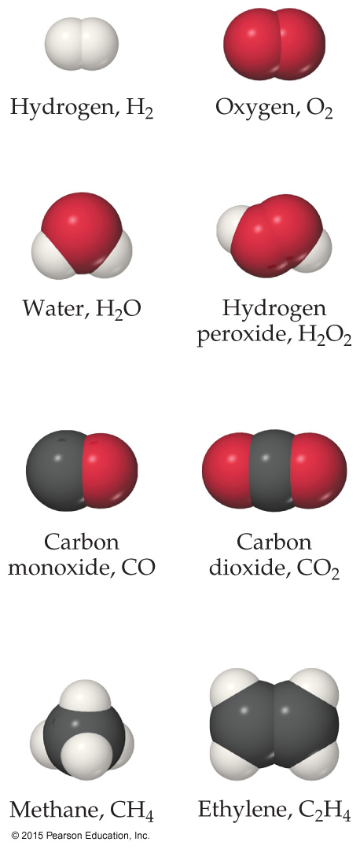
Chemical Formulas (化学式)
The subscript to the right of the symbol of an element tells the number of atoms of that element in one molecule of the compound.
Molecular compounds (分子化合物) are composed of molecules and almost always contain only nonmetals.
He H₂ H₂O

Slide 42
Diatomic Molecules
These seven elements occur naturally as molecules containing two atoms:
Hydrogen H₂
Nitrogen N₂
Oxygen O₂
Fluorine F₂
Chlorine Cl₂
Bromine Br₂
Iodine I₂

Slide 43
Types of Formulas
Empirical formulas (最简式) give the lowest whole-number ratio of atoms of each element in a compound.
Molecular formulas (分子式) give the exact number of atoms of each element in a compound.
If we know the molecular formula of a compound, we can determine its empirical formula. The converse is not true!

Slide 44
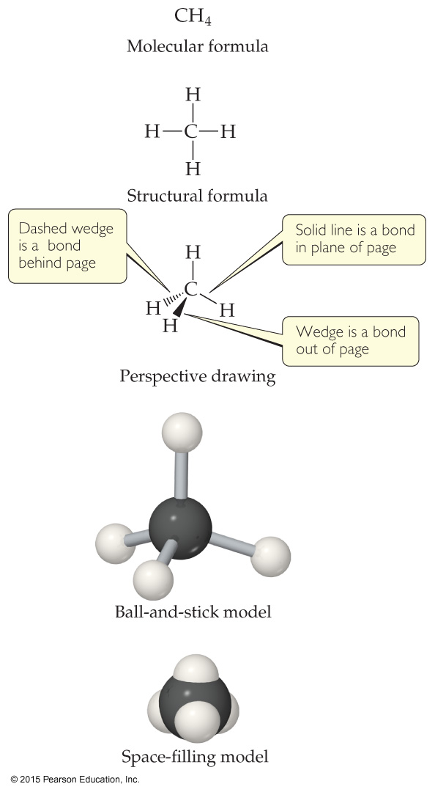
Types of Formulas
Structural formulas show the order in which atoms are attached. They do NOT depict the three-dimensional shape of molecules.
Perspective drawings also show the three-dimensional order of the atoms in a compound. These are also demonstrated using models.

Slide 45
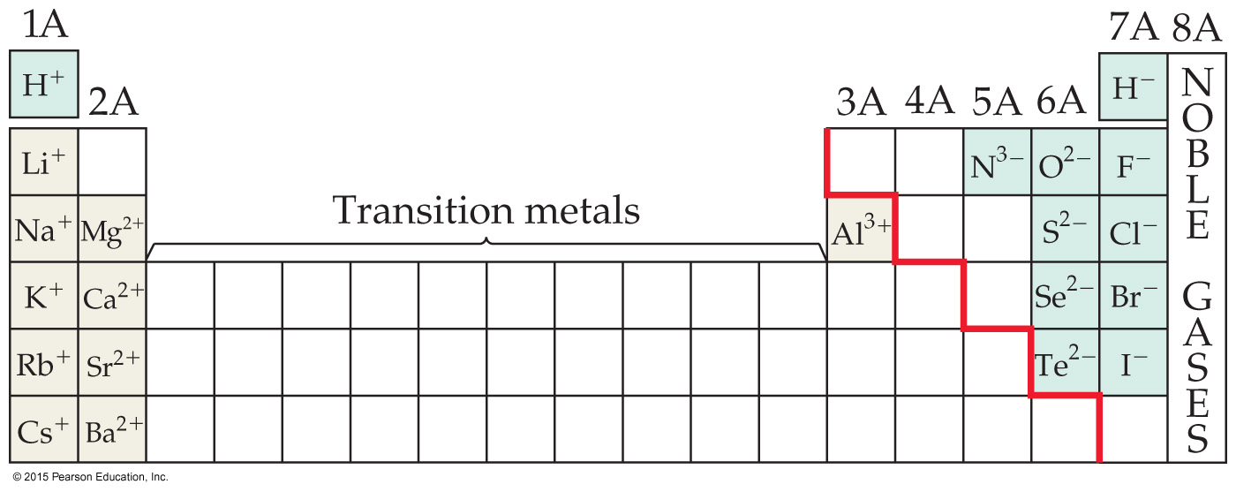
Ions
When an atom of a group of atoms loses or gains electrons, it becomes an ion.
Cations (阳离子, cat-ion) are formed when at least one electron is lost. Monatomic cations are formed by metals.
Anions (阴离子, An-ion) are formed when at least one electron is gained. Monatomic anions are formed by nonmetals.

Slide 46
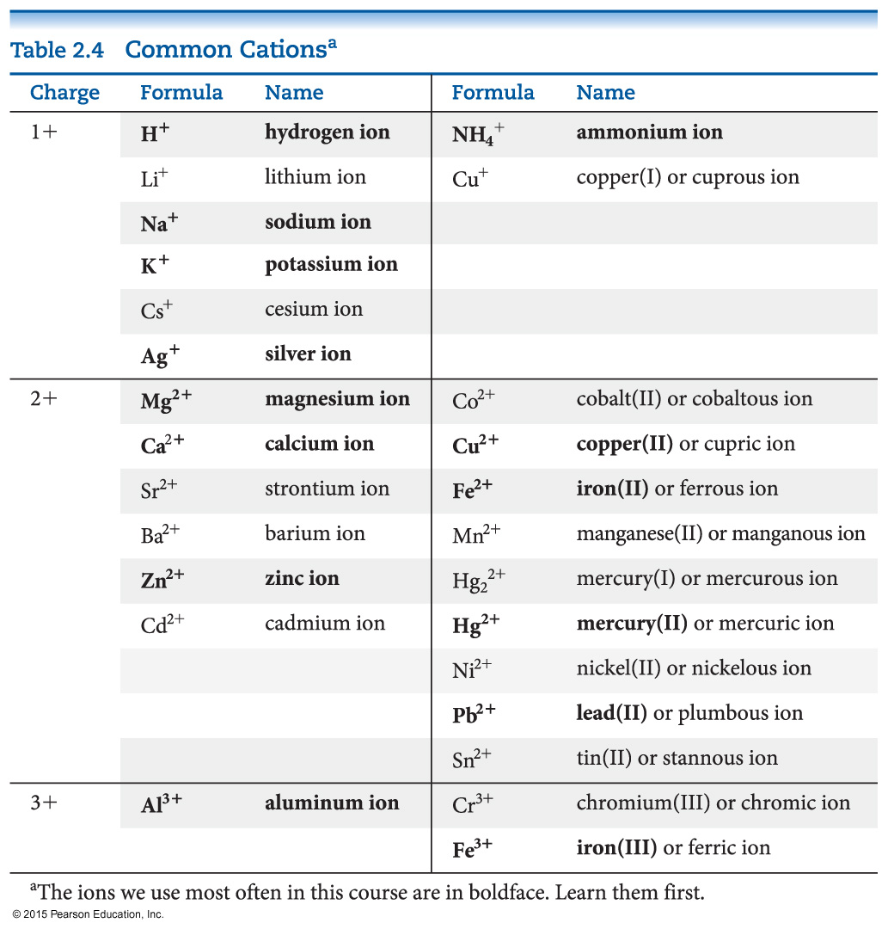
Common Cations

Slide 47
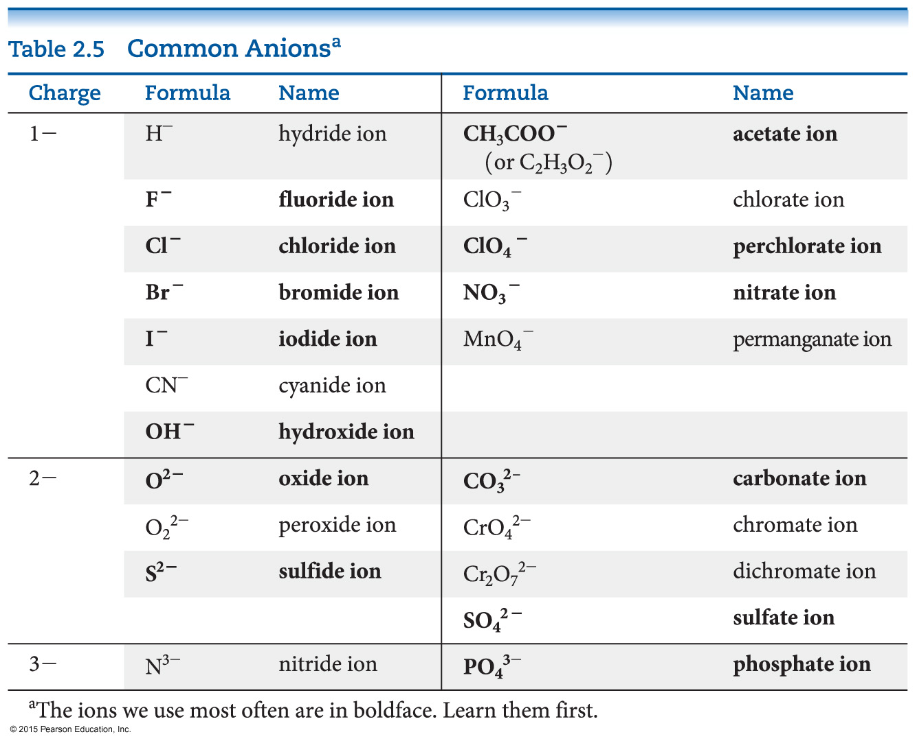
Common Anions

Slide 48
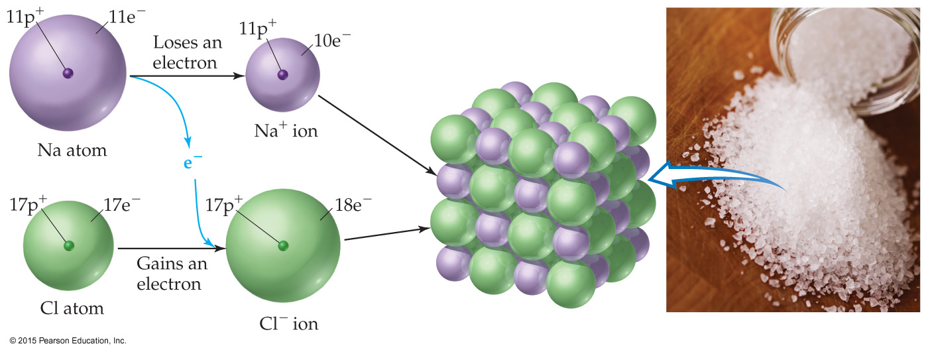
Ionic Compounds (离子化合物)
Ionic compounds (such as NaCl) are generally formed between metals and nonmetals.
Electrons are transferred from the metal to the nonmetal. The oppositely charged ions attract each other. Only empirical formulas are written.

Slide 49
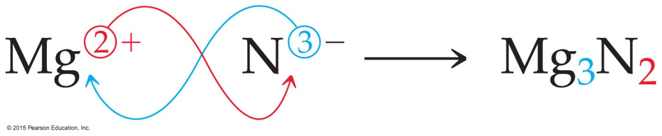
Writing Formulas
Because compounds are electrically neutral, one can determine the formula of a compound this way:
The charge on the cation becomes the subscript on the anion.
The charge on the anion becomes the subscript on the cation.
If these subscripts are not in the lowest whole-number ratio, divide them by the greatest common factor.

Slide 50
Inorganic Nomenclature (命名法)
Cation ions: single charge, different charges, nonmetal, (P 100)
Anion: monatomic, oxyanion, (P 102)
Ionic compound: Cation + Anion

Slide 51
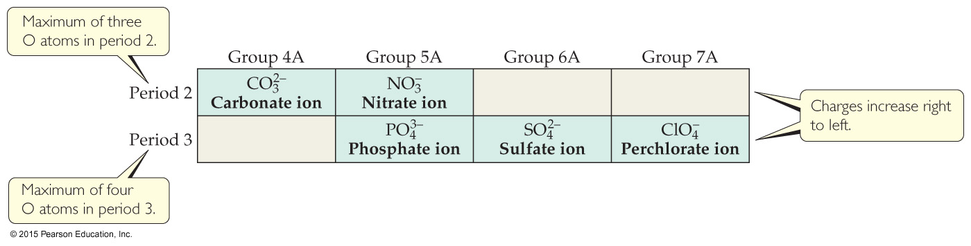
Patterns in Oxyanion Nomenclature
Central atoms on the second row have a bond to, at most, three oxygens; those on the third row take up to four.
Charges increase as you go from right to left.

Slide 52
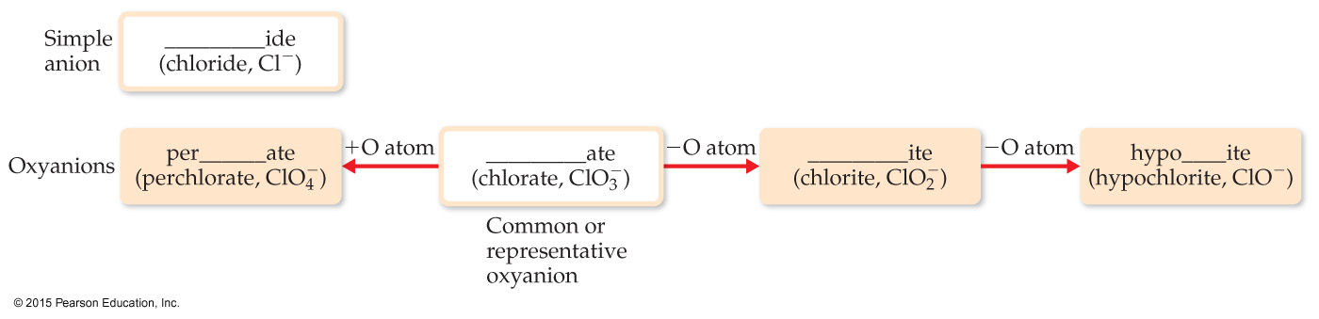
Patterns in Oxyanion Nomenclature

Slide 53
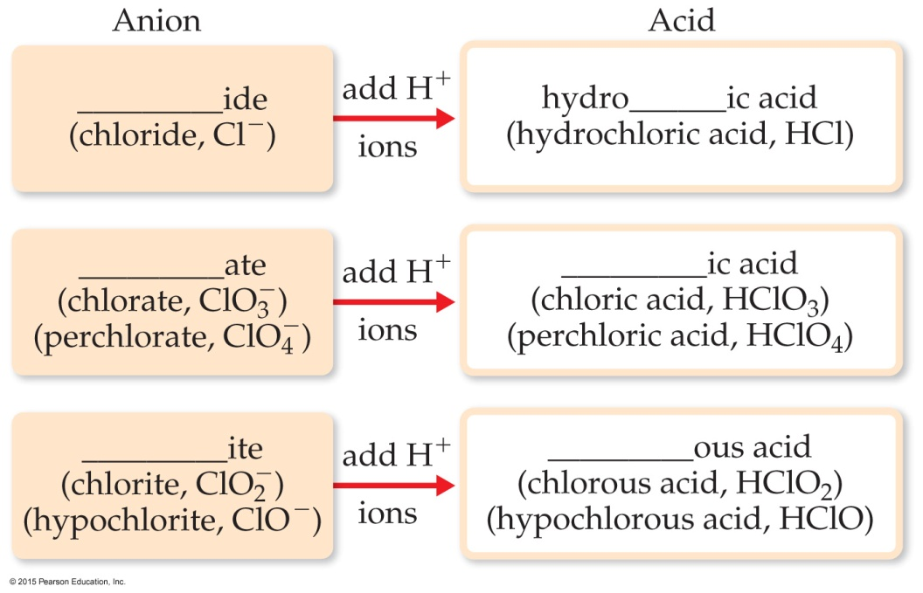
Acid Nomenclature
If the anion in the acid ends in -ide, change the ending to -ic acid and add the prefix hydro-.
HCl: hydrochloric acid
HBr: hydrobromic acid
HI: hydroiodic acid
If the anion ends in -ite, change the ending to -ous acid.
HClO: hypochlorous acid
HClO₂: chlorous acid
If the anion ends in -ate, change the ending to -ic acid.
HClO₃: chloric acid
HClO₄: perchloric acid

Slide 54
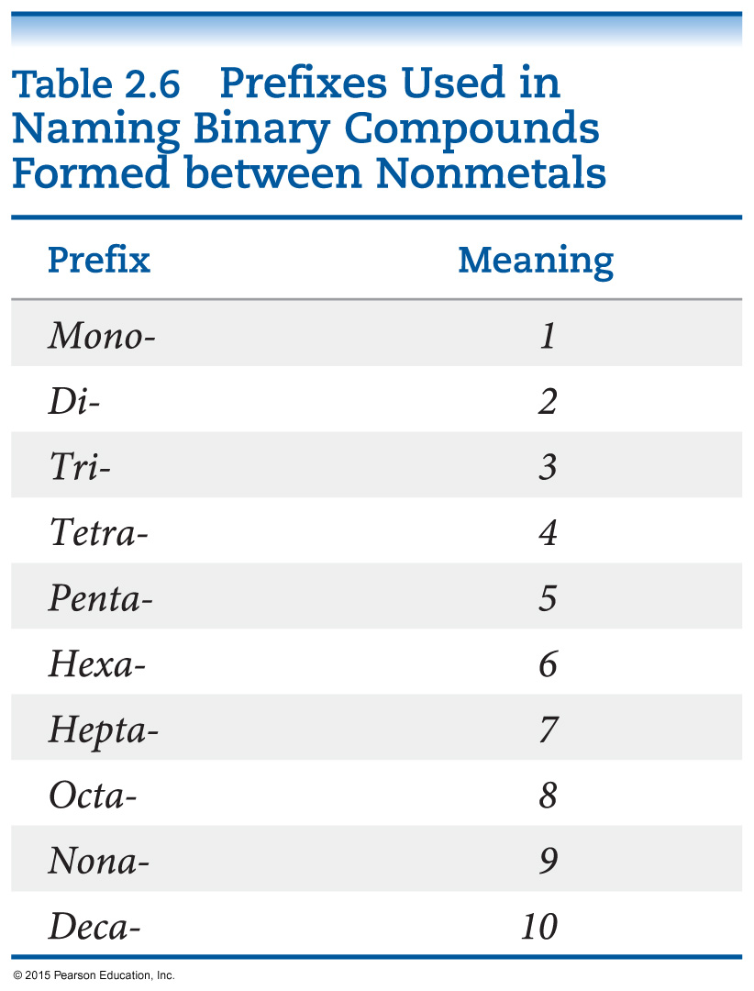
Nomenclature of Binary Molecular Compounds (P 106)
The name of the element farther to the left in the periodic table (closer to the metals) or lower in the same group is usually written first.
A prefix is used to denote the number of atoms of each element in the compound (mono- is not used on the first element listed, however).

Slide 55
Nomenclature of Binary Compounds
The ending on the second element is changed to -ide.
CO₂: carbon dioxide
CCl₄: carbon tetrachloride
If the prefix ends with a or o and the name of the element begins with a vowel, the two successive vowels are often elided into one.
N₂O₅: dinitrogen pentoxide

Slide 56
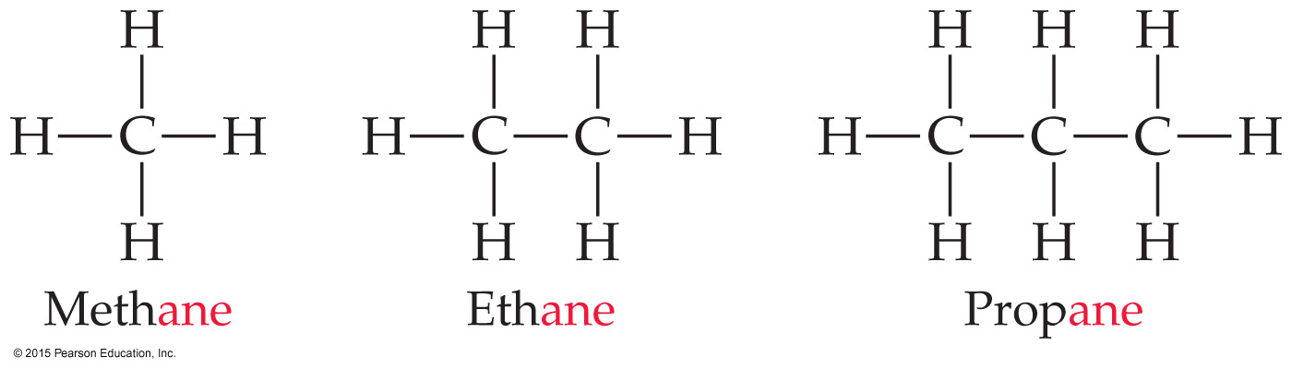
Nomenclature of Organic Compounds
Organic chemistry is the study of carbon.
Organic chemistry has its own system of nomenclature.
The simplest hydrocarbons (compounds containing only carbon and hydrogen) are alkanes.
The first part of the names just listed correspond to the number of carbons (meth- = 1, eth- = 2, prop- = 3, etc.).

Slide 57
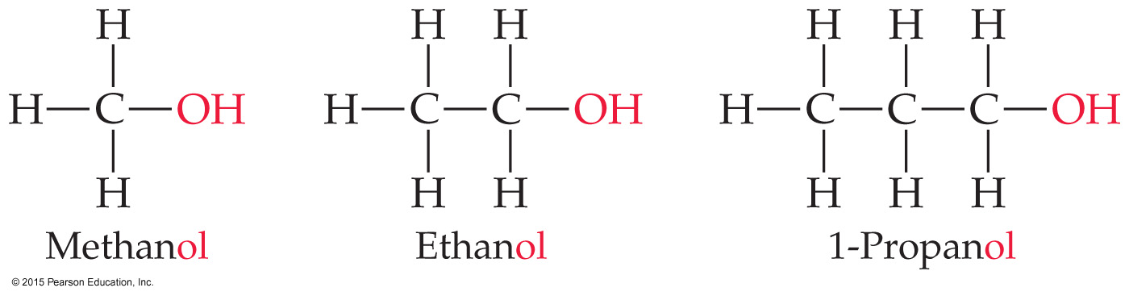
Nomenclature of Organic Compounds
When a hydrogen in an alkane is replaced with something else (a functional group, like -OH in the compounds above), the name is derived from the name of the alkane.
The ending denotes the type of compound.
An alcohol ends in -ol.

Slide 58
Metals and nonmetals react to form ________ compounds.
molecular
mixed
empirical
ionic
Notes:
Answer: d

Slide 59
Metals and nonmetals react to form ________ compounds.
molecular
mixed
empirical
ionic
Notes:
Answer: d

Slide 60
Positive ions are called
positrons.
anions.
cations.
nucleons.
Notes:
Answer: c

Slide 61
Positive ions are called
positrons.
anions.
cations.
nucleons.
Notes:
Answer: c

Slide 62
Compounds composed only of carbon and hydrogen are called
binary acids.
carbohydrates.
hydrocarbons.
alkanes.
Notes:
Answer: c

Slide 63
Compounds composed only of carbon and hydrogen are called
binary acids.
carbohydrates.
hydrocarbons.
alkanes.
Notes:
Answer: c

Slide 64
The elements located in Group VIIA (Group 17) on the periodic table are called
alkali metals.
noble gases.
chalcogens.
halogens.
Notes:
Answer: d

Slide 65
The elements located in Group VIIA (Group 17) on the periodic table are called
alkali metals.
noble gases.
chalcogens.
halogens.
Notes:
Answer: d

Slide 66
Which name is incorrectly paired with the formula?
hydroxide ion; OH–
barium(II) chloride; BaCl₂
ammonia; NH₃
sulfur dioxide; SO₂
Notes:
Answer: b

Slide 67
Which name is incorrectly paired with the formula?
hydroxide ion; OH–
barium(II) chloride; BaCl₂
ammonia; NH₃
sulfur dioxide; SO₂
Notes:
Answer: b

Slide 68
Acids produce _____ ions.
OH^{–1}
OH⁺¹
H⁺¹
H^{–1}
Notes:
Answer: c

Slide 69
Acids produce _____ ions.
OH^{–1}
OH⁺¹
H⁺¹
H^{–1}
Notes:
Answer: c

Slide 70
NaClO is named
sodium chlorate.
sodium chlorite.
sodium perchlorate.
sodium hypochlorite.
Notes:
Answer: d

Slide 71
NaClO is named
sodium chlorate.
sodium chlorite.
sodium perchlorate.
sodium hypochlorite.
Notes:
Answer: d

Slide 72
LiNO₃ is named
lithium nitrate.
lanthanum nitrate.
lanthanum nitrite.
lithium nitrite.
Notes:
Answer: a

Slide 73
LiNO₃ is named
lithium nitrate.
lanthanum nitrate.
lanthanum nitrite.
lithium nitrite.
Notes:
Answer: a

Slide 74
The formula for aluminum carbonate is
Al₂(CO₃)₃.
AlCO₃.
Al₂C₃.
Al₃(CO₃)₂.
Notes:
Answer: a

Slide 75
The formula for aluminum carbonate is
Al₂(CO₃)₃.
AlCO₃.
Al₂C₃.
Al₃(CO₃)₂.
Notes:
Answer: a

Slide 76
Fe₂O₃ is named
diiron trioxide.
iron(III) oxide.
ferrous oxide.
ironic oxide.
Notes:
Answer: b

Slide 77
Fe₂O₃ is named
diiron trioxide.
iron(III) oxide.
ferrous oxide.
ironic oxide.
Notes:
Answer: b

Slide 78
Which acid is not an oxyacid?
hydrochloric acid
nitric acid
sulfurous acid
acetic acid
Notes:
Answer: a

Slide 79
Which acid is not an oxyacid?
hydrochloric acid
nitric acid
sulfurous acid
acetic acid
Notes:
Answer: a

Slide 80
HIO₄ is named
iodic acid.
iodous acid.
periodic acid.
hydrogen iodate.
Notes:
Answer: c

Slide 81
HIO₄ is named
iodic acid.
iodous acid.
periodic acid.
hydrogen iodate.
Notes:
Answer: c

Slide 82
Cl₂O₇ is named
chlorine(VII) oxide.
dichlorine hexaoxide.
dichlorine heptaoxide.
bichlorine heptaoxide.
Notes:
Answer: c

Slide 83
Cl₂O₇ is named
chlorine(VII) oxide.
dichlorine hexaoxide.
dichlorine heptaoxide.
bichlorine heptaoxide.
Notes:
Answer: c

Slide 84
C₃H₈ is named
ethane.
propane.
propanol.
pentane.
Notes:
Answer: b

Slide 85
C₃H₈ is named
ethane.
propane.
propanol.
pentane.
Notes:
Answer: b

